Slide 1
IT Module PPT
Aritra Pain (AF05098710)
Data Processing & Business Analysis (D3870)

Slide 2
Introduction to Information Technology
Role of IT in Modern Business
Business Systems Overview (ERP, CRM, BI)
Enterprise Resource Planning (ERP)
Business Strategy & IT Alignment
Types and Sources of Data
Data Lifecycle & Governance
Role of a Business Analyst
Agile vs Waterfall Methodologies
Stakeholder Management
Scenario Analysis
Ethical Use of Data & Compliance
Conclusion
Agenda

Slide 3
Introduction to Information Technology
Information Technology (IT) refers to the use of computers, software, networks, and digital systems to store, process, secure, and transmit information.
In modern organizations, IT is not just a support function — it is a strategic enabler that drives efficiency, innovation, and competitive advantage.

Slide 4
Importance of IT in Modern Business
Automates business processes and reduces manual errors
  Enables fast communication (email, video conferencing, collaboration tools)
  Supports data-driven decision making
  Enhances productivity and operational efficiency
  Drives innovation in finance, healthcare, retail, and education
IT transforms traditional businesses into digital enterprises.

Slide 5
Core Components of IT
Hardware – Computers, servers, routers, storage devices
Software – Operating systems and business applications
Networking – LAN, WAN, Internet connectivity
Data – Raw facts transformed into meaningful insights
People & Processes – Users and workflows managing systems
All components work together to deliver business value.

Slide 6
Business Systems Overview
Modern organizations use integrated business systems such as:
ERP (Enterprise Resource Planning)
CRM (Customer Relationship Management)
BI (Business Intelligence)
SCM (Supply Chain Management)
These systems improve coordination across departments.

Slide 7
Enterprise Resource Planning (ERP)
ERP is an integrated software system that manages core business functions in a unified platform.
It centralizes data from:
Finance
HR
Inventory
Sales
Production
ERP provides real-time visibility across the organization.

Slide 8
Benefits of ERP
• Improved operational efficiency
  Reduced duplication of data
  Real-time reporting and analytics
  Better collaboration between departments
  Scalability as the organization grows
ERP acts as a “single source of truth.”

Slide 9
ERP vs CRM
ERP focuses on internal operations such as finance, HR, and supply chain.
CRM focuses on customer relationships, sales tracking, and marketing campaigns.
ERP improves efficiency.
CRM improves customer satisfaction and revenue
growth.
Both systems complement each other.

Slide 10
Business Strategy & IT Strategy
Business Strategy defines long-term organizational goals.
IT Strategy defines how technology will support those goals.
Alignment between business and IT ensures:
  Efficient resource utilization
  Strategic advantage
  Sustainable growth
Without alignment, technology investments may fail.

Slide 11
Types of Data
Structured Data – Stored in tables (e.g., databases, Excel)
Semi-Structured Data – JSON, XML with partial organization
Unstructured Data – Text, images, videos, social media
Most modern business data is unstructured.
Effective management of all types is essential for analytics.

Slide 12
Data Sources
• Internal Data – Sales, HR, inventory records
  External Data – Market trends, competitor information
  Third-Party Analytics – Google Analytics, marketing tools
  Open Data – Government statistics, public datasets
Combining multiple sources improves decision-making.

Slide 13
Data Lifecycle Management
Data Lifecycle includes:
Data Creation
Data Storage
Data Processing
Data Analysis
Data Archiving or Deletion
Proper lifecycle management ensures security and compliance.

Slide 14
Role of a Business Analyst
A Business Analyst acts as a bridge between business stakeholders and technical teams.
Key Responsibilities:
  Requirement gathering
  Data analysis
  Process improvement
  Documentation
  Solution validation
They ensure business problems are solved effectively.

Slide 15
Skills of a Business Analyst
• Analytical thinking
  Communication skills
  Problem-solving ability
  Knowledge of SQL, Excel, BI tools
  Understanding of business domains
Strong collaboration skills are critical.

Slide 16
Agile Methodology
Agile is an iterative approach that delivers work in short cycles called sprints.
Advantages:
  Flexible to change
  Continuous customer feedback
  Faster delivery
Best for dynamic and evolving projects.

Slide 17
Waterfall Methodology
Waterfall is a linear and sequential approach.
Phases include:
  Requirements
  Design
  Development
  Testing
  Deployment
Best suited for projects with stable requirements.

Slide 18
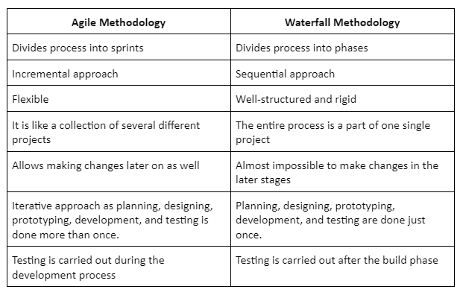
Agile vs Waterfall (Comparison)

Slide 19
Stakeholder Management
Stakeholder management involves:
• Identifying stakeholders
  Analyzing their influence
  Managing expectations
  Maintaining transparent communication
Effective stakeholder engagement increases project success.

Slide 20
Scenario Analysis
Scenario analysis evaluates different possible futures:
• Best-case scenario
  Worst-case scenario
  Most-likely scenario
It helps organizations prepare for risks and make strategic decisions.

Slide 21
Data Governance
Data governance ensures that data is:
• Accurate
  Secure
  Consistent
  Used responsibly
It defines roles, policies, and standards for managing data.

Slide 22
Ethical Use of Data
Ethical data use includes:
• Transparency and consent
  Data minimization
  Fairness and non-discrimination
  Accountability
Organizations must protect user privacy and maintain trust.

Slide 23
GDPR vs CCPA
Both regulations protect personal data.
GDPR – European Union regulation, strict consent rules CCPA – California law focused on consumer rights
Non-compliance can result in heavy penalties.

Slide 24
Conclusion
Information Technology is the backbone of modern business.
ERP and business analysis improve operational efficiency.
Data-driven strategy enhances competitiveness.
Strong alignment between business and IT ensures long-term success.

Slide 25
Thank you

